Slide 2
Drug Laws, Incarceration and TB in Mexico, the perfect storm?
Tania Ramírez
@tan_tlacaelelt
Share your thoughts on this presentation with #IAS2019

Slide 3
Imprisonment in the Americas: the most popular response
Americas: criminal law and incarceration to tackle various social problems, including illegal drug markets
Prison has become the first response for resolving a series of social issues
Growing use of Pre-trial detention
Special regime for organized crime, including drug traficking (e.g. Mexico & Colombia)
Increase in years of prison sentences for different crimes
Drug offenses: more drug-related behaviors considered as crimes and big penalties for drug offenses
Notes:
Trend of maximizing the use of criminal law and prisons to tackle various social problems, including illegal drug markets – and governments in Latin America are not an exception. They have frequently relied upon criminal law as the primary response to crime and violence in the region
Cata y Sergio:
Particularly noticeable for drug crimes
clear expansion in the use of criminal law in the matter of drugs, to the point that in some of them it has reached to be sanctioned with a greater prison sentence - and therefore considered more serious - to sell cocaine to someone willing to buy it, to deliberately murder a neighbor or commit a rape. According to the cited text, since 1970, Latin America shows both an increase in the number of articles that typify drug-related behaviors, as well as the number of governing verbs included in each article, as well as the penalties with which they are punished.
Expansion of criminal law for drug related crimes

Slide 4
Drug laws and punishment
“War on drugs”: punitive approach & enforcement rather than focus on public health, human rights and human development.
Large number of people incarcerated for low-level, non-violent drug offenses (cultivating, selling, and even consumption).
This has aggravated the crisis in the region’s penitentiary systems: “the Americas is the region where the prison population has grown the fastest in the 21st century. Excluding the United States, the prison population in the Americas has grown 108%, or 6.3 times faster than the general population” (CEDD, 2018).
Overuse of incarceration has been ineffective in reducing problematic drug use and in combating organized crime, yet has resulted in enormous costs and produced adverse consequences.
Source: Irrational Punishment. Drug Laws and Incarceration in Latin America, CEDD, 2017
Notes:
-Although the incarceration crisis can be explained by the excessive use of criminal law in general, this tool is abused even more in the case of drug policies.
-However, the overuse of incarceration has been ineffective in reducing problematic drug use and in combating organized crime, yet has resulted in enormous costs and produced adverse consequences.
CEDD: http://fileserver.idpc.net/library/Irrational_Punishments_ok.pdf
Addicted to Punishment (Uprimny et al., 2012)

Slide 5
Drug offenses
Characteristics:
Imposition of extremely harsh and disproportionate sanctions,
Use of mandatory minimum sentences,
Obligatory use of pretrial detention for these offenses, and
Lack of use of alternatives to incarceration.
PWUD is often arrested, extorted and even incarcerated as small-scale or retail dealers for possessing quantities of drugs that are above of tolerated levels for personal use.
Most of the population imprisoned for drug offenses are persons accused of possession, or people who is part of the lowest levels of the drug trafficking chain.
Notes:
Los excesos en el poder punitivo de los Estados en las distintas fases de la criminalización en materia de drogas –desde la definición de los tipos penales hasta la determinación judicial de las penas–, contribuyen a explicar el siguiente hecho: si bien la población encarcelada ha crecido a unos ritmos alarmantes en las Américas, mayores a los del resto del mundo, el crecimiento de las personas encarceladas por delitos de drogas ha sido todavía más acelerado en la mayoría de los países.

Slide 6
Drug Laws and mass incarceration
The population for drug offenses grew more rapidly than the general prison population.
Americas: the population imprisoned for drug offenses increased faster than the population imprisoned for other offenses, at a rate between 8 and 33 times higher (CEDD, 2018).
Mexico: while the prison population increased by 7%, population incarcerated for drug offenses grew by 19%.
Source: Pérez Correa & Chaparro Hernández, Sobredosis carcelaria y política de drogas en A.L., 2017
Notes:
Latin American prisons are overflowing with people charged with drug-related offenses, with a substantial proportion in pretrial detention.175 Arrests and incarceration for drug possession and other minor drug crimes are excessive, and sentences are harsh.176 According to the Colectivo de Estudios Drogas y Derecho (CEDD), approximately 20 percent of the prison population in Latin America is charged with drug-related crimes.177 In March 2017, the CEDD reported that, in the previous fifteen years, the population in prison for drug-related crimes had risen between eight and thirty-three times faster than the general prison population in nine Latin American countries,178 depending on the country.179
-In all of the countries, with the exception of Bolivia
-In six of the nine countries analyzed,
En Brasil, mientras que la población carcelaria se incrementó en 55%, la encarcelada por delito de drogas creció 267%, es decir, a un ritmo cinco veces mayor
at a rate five times higher

Slide 7
Impact of drug-related crimes on the prison system
2.7 million people incarcerated: 572 thousand are imprisoned for drug offenses, (which represents one in five inmates, with a slight tendency to rise)
Prisoners for drug crimes ranges from 10 to 28% of the prison population.
It represents between the second and the fourth cause of imprisonment in these countries.
In addition, pretrial detention is regularly applied to drug-related cases, without any distinction made regarding the type of offense or the sanction to be imposed.
Source: Pérez Correa & Chaparro Hernández, Sobredosis carcelaria y política de drogas en A.L., 2017
Notes:
Como se muestra en la tabla 4, en 6 de los 10 países estudiados, los delitos de drogas representaron, en el último año reportado, una mayor participación porcentual de la población carcelaria que en el primer año reportado. De los más de 2,7 millones de personas encarceladas en estos países, 572 mil lo están por delitos de drogas, lo que representa una de cada cinco personas, con una leve tendencia al ascenso. La participación de los presos por delitos de drogas oscila entre 10 y el 28% de la población carcelaria, lo cual la sitúa entre la segunda y la cuarta causa de mayor encarcelamiento en estos países

Slide 8
Drug-related crimes and overpopulation
Drug-related crimes represent 64% of the average prison overcrowding in these countries
Prisons in the region: overcrowding, scarce resources and extreme conditions of violence.
The lack of hygiene, of drinking water, basic essentials and sufficient space contribute to a high prevalence of contagious diseases that endanger the health of inmates, their relatives and detention center employees. The use of prisons to address the drug issue undermines health, rather than protecting it
Source: Pérez Correa & Chaparro Hernández, Sobredosis carcelaria y política de drogas en A.L., 2017
Notes:
¿Cómo afectan los delitos de drogas la capacidad penitenciaria en países de la región? La gráfica 14 muestra –en las barras– la comparación entre el tamaño de la población encarcelada por delitos de drogas y la sobrepoblación carcelaria existente en los nueve países estudiados por el CEDD. En las líneas se compara la sobrepoblación actual con la tasa de sobrepoblación en el hipotético caso que las personas encarceladas por drogas no estuvieran en prisión.19 Para el ejercicio, es imposible dividir los tipos de delitos de drogas (entre los más graves y los menos graves). Sin embargo, estudios previos del CEDD muestran que la mayor parte de la población encarcelada por delitos de drogas son personas acusadas de posesión, usuarios o que ocupan los niveles más bajos de la cadena de narcotráfico (CEDD, 2014). Por tanto, la disminución que se muestra sería menor en el caso hipotético de que solo las personas acusadas por delitos menores o no violentos de drogas fueran excarceladas. Bajo esta hipótesis, el hacinamiento carcelario promedio caería del 56 al 20%. Visto en otros términos, la criminalización de conductas relacionadas con drogas explica un 64% de la sobrepoblación carcelaria promedio en los países estudiados. En este ejercicio hipotético, es decir, si se excarcela a quienes están privados de la libertad por delitos de drogas, la sobrepoblación desaparecería en Argentina, Uruguay y Ecuador. En Perú disminuiría del 134 al 45%, y en Brasil del 57 al 13%

Slide 9
Prison system in Mexico
Overview
Prison population total | 204,422
Prison population rate | 164 per 100,000
Gender | 94.8% male, 5.2% female
Juvenile | 4.3%
Pre-trial detainees | 39.2%
Number of institutions | 342
Source: World Prison Brief, March 2018
Notes:
List of the 10 countries with the biggest prison population
There are more than 2.1 million prisoners in the United States of America, 1.65 million in China (plus unknown numbers in pre-trial detention and other forms of detention), 690,000 in Brazil, 583,000 in the Russian Federation, 420,000 in India, 364,000 in Thailand, 249,000 in Indonesia, 233,000 in Turkey, 230,000 in Iran, 204,000 in Mexico and 188,000 in the Philippines
-Prison population total (including pre-trial detainees / remand prisoners)
-(That is, the number of prisoners per 100,000 of the national population)
El uso excesivo de la prisión preventiva causa el hacinamiento de las cárceles mexicanas
2017: 35% of inmates have not received sentencia (CESOP, 2019), de este total, el 44 % eran mujeres que aún se encontraban sujetas a proceso.
1/3 de la población se encuentra en cárceles de la Ciudad de México (30.979 reos) o el Estado de México (25.723 prisioneros)
en algunos países, como México, las cifras oficiales reportan que 43% de las personas privadas de la libertad (a nivel federal) lo están por delitos de drogas
In Mexico, for example, the Constitution establishes that pretrial detention is mandatory for a catalogue of offenses, including those that the law defines as serious crimes against health, or that involve drugs.

Slide 10
Occupancy level
Occupancy level: 94.4%
45.6% of inmates shared their jail cell with more than 5 people:
Federal prisons: 4.5%
Local prisons: 51.1%. There are up to 30 inmates in areas where only four must live (CNDH, 2017)
Source: World Prison Brief, March 2018.
Source: INEGI, 2018.
Notes:
Occupancy level (based on official capacity)
2016: 45.6% de la población privada de la libertad a nivel nacional compartió su celda con más de cinco personas. En Centros Penitenciarios Federales, esta cifra fue de 4.5%; mientras que en Centros Estatales y Municipales fue de 51.1%

Slide 11
Mexico: ¿drug use decriminalization?
War on Drugs 2006
“Ley de Narcomenudeo” (2009): treshold system
Individuals could be arrested and incarcerated when caught in possession of an amount of drugs that exceeded the “maximum dosage for personal use” (5 grams in the case of cannabis) but remained below the threshold for “large scale trafficking”
Pre-trial detention mandatory for drug-related crimes (“crimes against health”)
Notes:
The so-called “Small trafficking law”, introduced in 2009 as part of President Calderon’s disastrous drug war crackdown, allowed for state governments to prosecute some drug-related offenses previously reserved to federal authorities.
México has a general crime category called “crimes against health” that includes a broad range of offences relating to drugs (including cultivation, processing, transportation, sale or supply, purchase, possession, or consumption) but makes no recorded distinction
Ironically, this situation worsened as major legislative changes were adopted that were supposedly designed to decriminalise drug use and small-scale possession for personal use.
The law introduced a threshold system that, instead of facilitating judges to effectively decriminalise use and possession for personal use, ultimately served to allow state-level enforcement authorities to participate in and dramatically increase arrests and incarceration for low-level drug offences. Under the new legal framework, individuals could be arrested and incarcerated by state police and prosecutors when caught in possession of an amount of drugs that exceeded the “maximum dosage for personal use” (5 grams in the case of cannabis) but remained below the threshold for “large scale trafficking” (set at 1000 times the lower personal use threshold).
The effect of such legislative change –whether intentional or not– was to dramatically widen the scope of drug enforcement, increasing the number of harshly punishable offences and leading to a jump in prosecutions and imprisonments at state level -although unevenly distributed between and within states.
Fuente: UNODC 2016. México: población interna en centros federales

Slide 12
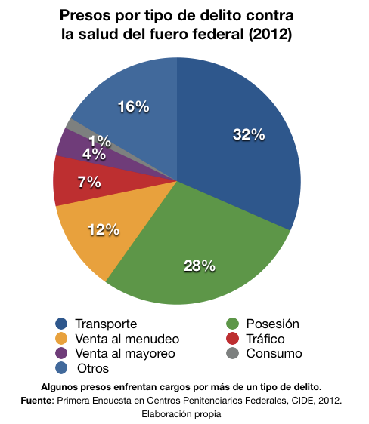
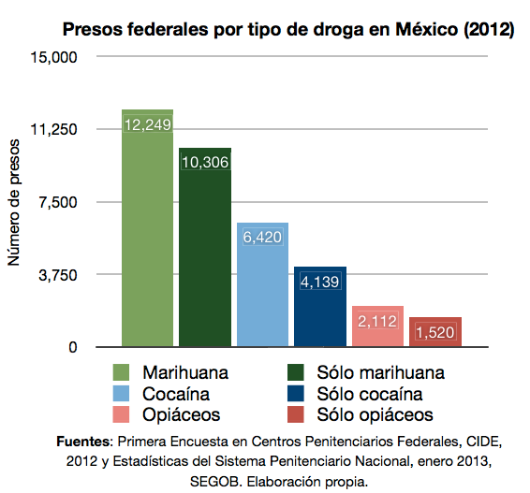
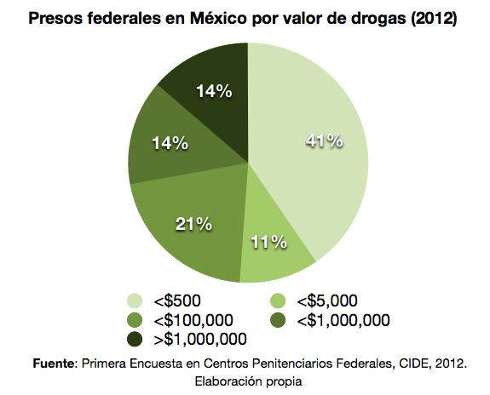
Who are they?
Inmates at Federal level by crime (crimes against health) (2012)
Inmates at Federal level by drugs (Mexican pesos) (2012)
Inmates at Federal level by monetary value of (Mexican pesos) (2012)
Transportation
Retail sale
Wholesale sales
Other
Posession
Trafficking
Consumption
Source: 1a encuesta en Centros Penitenciarios Federales (CIDE 2012)
Notes:
Según datos de la PGR, entre 2006 y 2014 fueron detenidas 453,069 personas en el ámbito federal por delitos contra la salud.
De estos, 175,993 fueron detenidos por posesión (en sus diversas modalidades) y 156,189 por consumo (a pesar de que el consumo no es un delito).
Es decir, 73.27% de las personas detenidas a nivel federal por delitos relacionados con las drogas eran poseedores o consumidores de alguna sustancia ilícita (CEDD, 2015).
4 de cada 10 presos por mariguana está en la cárcel por cantidades pequeñas cuyo valor no supera los 500 pesos.
Statistics show that, far from targeting the most dangerous criminals, drug enforcement primarily criminalises people who use drugs, and is directly causing prison overcrowding. There is, however, little or no evidence of that illegal drug markets are being disrupted (beyond marginal, localized, temporary ‘success’), or drug use significantly deterred
The lack of precise information regarding the specific crime people are charged with when arrested for drug offences (whether it’s simple possession, trafficking, transport or cultivation) shows that drug enforcement in Mexico still doesn’t distinguish between different levels of participation in the illicit economy and that the severity of its drug laws (allowing for preventive detention in most cases) create perverse incentives to poorly construct files and reporting systems. This reflects that in many cases small scale cannabis arrests continue to be deployed as a proxy enforcement tool, a problem that still needs to be addressed regardless of how good or badly the decarceration benefit is implemented.
México has a general crime category called “crimes against health” that includes a broad range of offences relating to drugs (including cultivation, processing, transportation, sale or supply, purchase, possession, or consumption) but makes no recorded distinction.

Slide 13
Pre-trial detention in Mexico
Pre-trial detention mandatory for drug-related crimes
(“crimes against health”)
Year | Number in pre-trial imprisonment | Percentage of total prison population | Pre-trial population rate
2000 | 63,724 | 41.2% | 64
2005 | 87,844 | 42.7% | 83
2010 | 91,297 | 41.7% | 81
2015 | 102,740 | 41.5% | 85
2018 | 79,660 | 39.2% | 64
Notes:
It consists of the number of pre-trial/remand prisoners in the prison population on a single date in the year (or the annual average) and the percentage of the total prison population that pre-trial/remand prisoners constituted on that day.
The final column shows the pre-trial/remand population rate per 100,000 of the national population.
blación privada de la libertad por tipo de centro penitenciario según situación jurídica y sexo A diciembre de 2016

Slide 14
Prison and the Right to Health
2014: 447 social rehabilitation centers, 228 have a medical service
Far from protecting health, the prison creates dangerous conditions of risk both for the inmates and for their families.
The use of prisons to address the drug issue undermines health, rather than protecting it. There is a high prevalence of the use of illicit drugs within prisons, so that imprisonment, far from preventing its use, enhances it.
The OAS General Assembly and the Rapporteur on the Rights of Persons Deprived of Liberty have repeatedly underscored that overcrowding is the most serious problem affecting the majority of the penitentiary systems in the region, as it increases the levels of violence in prisons, creates an unhealthy sanitary and hygienic environment, and limits access to the already scarce opportunities for study and work, constituting a barrier for reentry.
Notes:
Características de la población privada de la libertad en México, INEGI, 2018

Slide 15
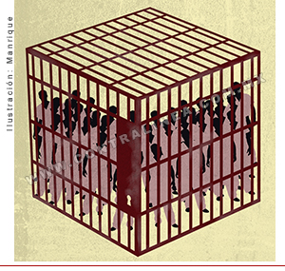
TB & prisons
Risk factors that increase the possibility of developing tuberculosis among inmates, employees and visitors:
rotation of inmates,
disproportionate number of inmates by cell
poor ventilation of many prisons,
drug abuse,
low poor access to health services and
the lack of implementation of prevention and disease control programs.
Floating population is also exposed to health risks: prisons were the point of infection for 8.3% of cases of tuberculosis in high-income countries and for 6.3% of cases in low-income countries (Baussano, 2010)
1% increase in the incarcerated population may generate a 0.34% increase in the prevalence rate of tuberculosis among the general population.

Slide 16
TB & prisons in Mexico
Prevalence rates of HIV and hepatitis B in prisons: 6.7% and 4.4% respectively (UNODC, 2012)
Prevalence rate of TB in prisons is on average 23 times higher than that of the general population (Baussano et al., 2010).
Mexico: 30 to 50 times more susceptible to developing TB
2014: 51% of Mexican prisons offered medical service
National TB strategy in prisons (2014): coordination, TB-AIDS actions, training and treatment
Notes:
-much higher than those of the general population.
-(those who visit inmates or work in prisons)
. The risk of disease is such that it has even been suggested
http://www.pensamientopenal.com.ar/system/files/2017/12/doctrina46053.pdf
Sergio y cata

Slide 17
TB incidence- Latin America 2016
Notes:
https://www.paho.org/hq/index.php?option=com_docman&view=download&category_slug=presentaciones-5882&alias=44088-dia-mundial-tuberculosis-2018-situacion-control-tb-americas-088&Itemid=270&lang=es

Slide 18
CESCR General Comment No. 14: The Right to the Highest Attainable Standard of Health (Art. 12)
“Health is a fundamental human right indispensable for the exercise of other human rights. Every human being is entitled to the enjoyment of the highest attainable standard of health conducive to living a life in dignity”
“States are under the obligation to respect the right to health by, inter alia, refraining from denying or limiting equal access for all persons, including prisoners or detainees”

